Slide 1
Introduction to Modern OpenGL codes
By Md. Tajmilur Rahman
Lecturer
CSE, KUET

Slide 2
Window Creation
// glfw: initialize and configure
// ------------------------------
glfwInit();
glfwWindowHint(GLFW_CONTEXT_VERSION_MAJOR, 3);
glfwWindowHint(GLFW_CONTEXT_VERSION_MINOR, 3);
glfwWindowHint(GLFW_OPENGL_PROFILE, GLFW_OPENGL_CORE_PROFILE);

Slide 3
Window Creation (contd.)
// glfw window creation// --------------------
GLFWwindow* window = glfwCreateWindow(SCR_WIDTH, SCR_HEIGHT, "CSE 4208: Computer Graphics Laboratory", NULL, NULL);
glfwMakeContextCurrent(window);

Slide 4
Window Termination
// glfw: terminate, clearing all previously allocated GLFW resources.
// ------------------------------------------------------------------
glfwTerminate();
return 0;

Slide 5
Function Pointer Loading
// glad: load all OpenGL function pointers
// ---------------------------------------
if (!gladLoadGLLoader((GLADloadproc)glfwGetProcAddress))
{
std::cout << "Failed to initialize GLAD" << std::endl;
return -1;
}

Slide 6
A Simple Render Loop
while (!glfwWindowShouldClose(window))
{
processInput(window);
glClearColor(0.2f, 0.3f, 0.3f, 1.0f);
glClear(GL_COLOR_BUFFER_BIT);
glfwSwapBuffers(window);
glfwPollEvents();
}

Slide 7
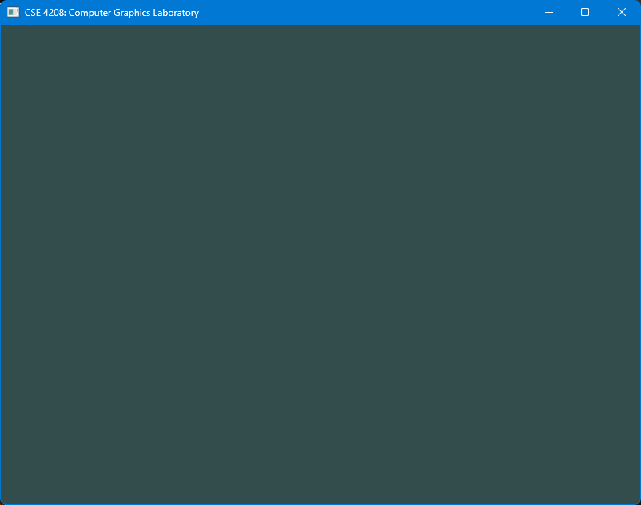
The Result

Slide 8
To Draw: Additional code in render loop
// draw our first triangle
glUseProgram(shaderProgram);
glBindVertexArray(VAO);
glDrawArrays(GL_TRIANGLES, 0, 3);

Slide 9
To Draw: What program?
const char* vertexShaderSource = "#version 330 core\n"
"layout (location = 0) in vec3 aPos;\n"
"void main()\n"
"{\n"
" gl_Position = vec4(aPos.x, aPos.y, aPos.z, 1.0);\n"
"}\0";

Slide 10
To Draw: What program? (contd.)
const char* fragmentShaderSource = "#version 330 core\n"
"out vec4 FragColor;\n"
"void main()\n"
"{\n"
" FragColor = vec4(1.0f, 0.5f, 0.2f, 1.0f);\n"
"}\n\0";

Slide 11
To Draw: What program? (contd.)
// vertex shader
unsigned int vertexShader = glCreateShader(GL_VERTEX_SHADER);
glShaderSource(vertexShader, 1, &vertexShaderSource, NULL);
glCompileShader(vertexShader);
// fragment shader
unsigned int fragmentShader = glCreateShader(GL_FRAGMENT_SHADER);
glShaderSource(fragmentShader, 1, &fragmentShaderSource, NULL);
glCompileShader(fragmentShader);

Slide 12
To Draw: What program? (contd.)
// link shaders
unsigned int shaderProgram = glCreateProgram();
glAttachShader(shaderProgram, vertexShader);
glAttachShader(shaderProgram, fragmentShader);
glLinkProgram(shaderProgram);

Slide 13
To Draw: What Vertex Array Object?
// set up vertex data (and buffer(s)) and configure vertex attributes
// ------------------------------------------------------------------
float vertices[] = {
-0.5f, -0.5f, 0.0f, // left
0.5f, -0.5f, 0.0f, // right
0.0f, 0.5f, 0.0f // top
};

Slide 14
To Draw: What Vertex Array Object? (contd.)
unsigned int VBO, VAO;
glGenVertexArrays(1, &VAO);
glGenBuffers(1, &VBO);
// bind the Vertex Array Object first, then bind and set vertex buffer(s), and then configure vertex attributes(s).
glBindVertexArray(VAO);
glBindBuffer(GL_ARRAY_BUFFER, VBO);
glBufferData(GL_ARRAY_BUFFER, sizeof(vertices), vertices, GL_STATIC_DRAW);

Slide 15
To Draw: What Vertex Array Object? (contd.)
glVertexAttribPointer(0, 3, GL_FLOAT, GL_FALSE, 3 * sizeof(float), (void*)0);
glEnableVertexAttribArray(0);
glBindVertexArray(0);

Slide 16
To Draw: That’s how it is
// draw our first triangle
glUseProgram(shaderProgram);
glBindVertexArray(VAO);
glDrawArrays(GL_TRIANGLES, 0, 3);

Slide 17
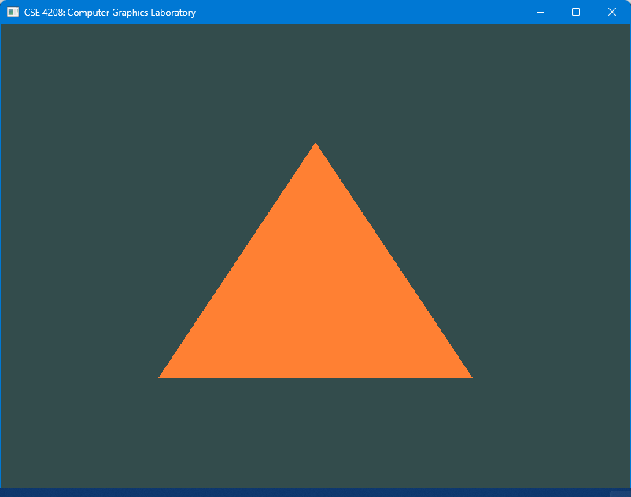
The result: Triangle

Slide 18
Thank you

